Slide 1
Quantum algorithms to find the low-energy states

Slide 2
Feedback-Based Quantum Optimization
PRL 129, 250502 (2022)
Goal: Find approximate solutions to the combinatorial optimization problem without the need for any classical optimization effort
Effectively the goal is to find the ground state

Slide 3
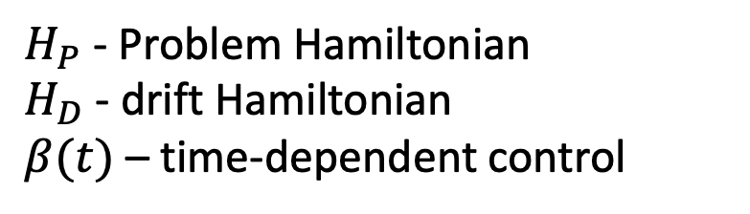
Main idea
Schrodinger equation:
$H_{P}$ - Problem Hamiltonian
$H_{D}$ - drift Hamiltonian
$β(t)$ – time-dependent control

Slide 4
Algorithm
One can choose
In practice

Slide 5
Example

Slide 6
Another example

Slide 7
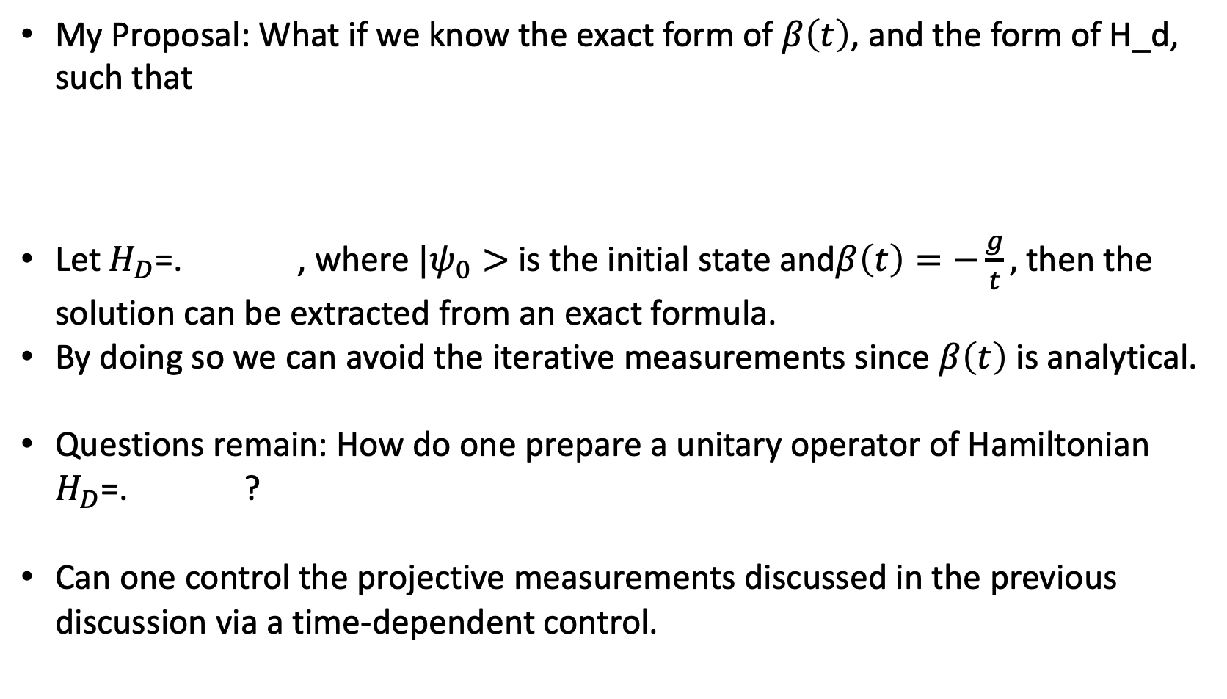
Brainstorming
My Proposal: What if we know the exact form of $β\left(t\right)$, and the form of H_d, such that
Let $H_{D}$=. , where $|ψ_{0}>$ is the initial state and$β\left(t\right)=−\frac{g}{t},$ then the solution can be extracted from an exact formula.
By doing so we can avoid the iterative measurements since $β\left(t\right)$ is analytical.
Questions remain: How do one prepare a unitary operator of Hamiltonian $H_{D}$=. ?
Can one control the projective measurements discussed in the previous discussion via a time-dependent control.
< 0

